Slide 1

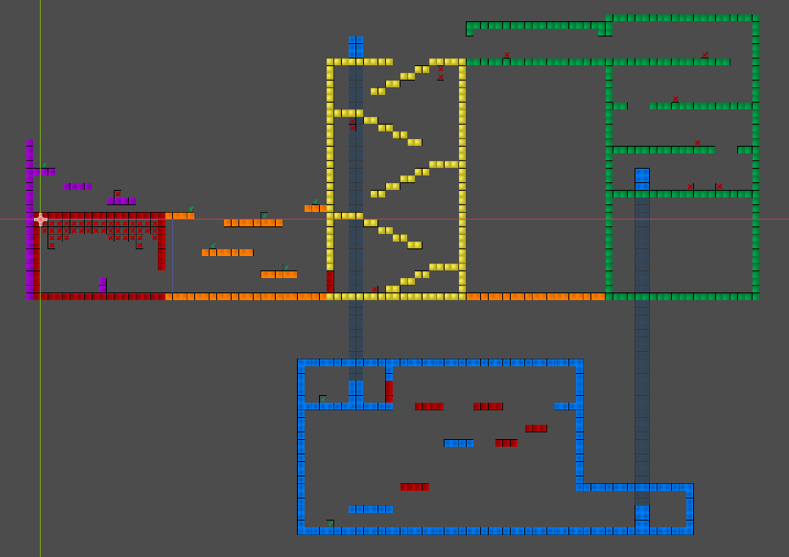

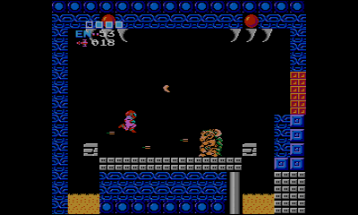
Project Metanarratroid
By team Mop-Up Games

Slide 2
Project
Overview
What is Metanarratroid?
Metanarratroid is a 2D side-scroller where the player upgrades not just themselves but the entire world around them, restoring reality after an apocalyptic eldritch entity destroyed it.
It fulfills a niche genre of games with a theme of “meta narratives” combining with overall upgrades to the game itself making it appealing for fans of upgrade-styled games, meta-narratives and metroidvanias.

Slide 3
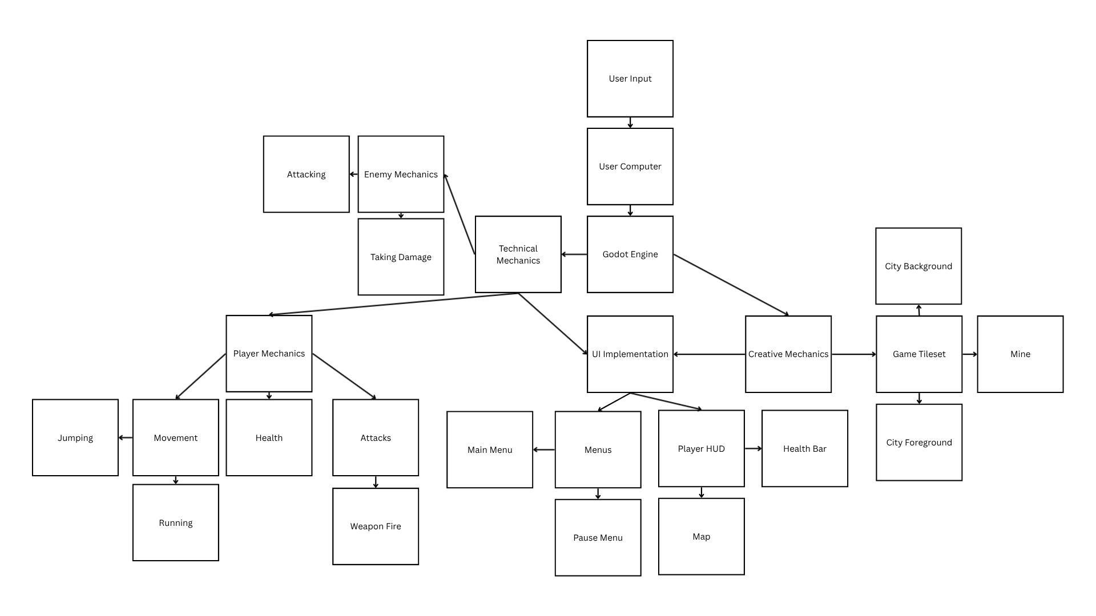
Software Architecture Design

Slide 4
User Interface Design

Slide 5
Completed Milestones

Slide 6
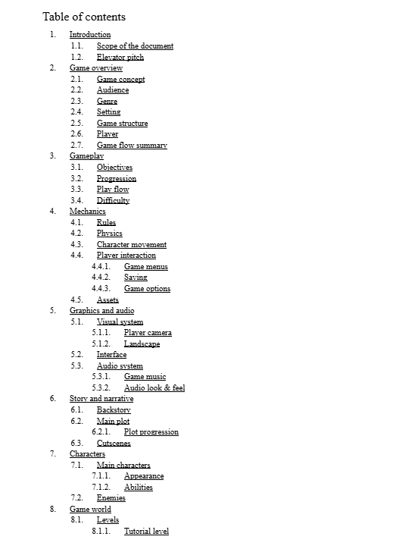
Completed Milestone:
Game Design Document
A game design document was completed to help portray the scope of the entire game, design details, and story elements. This helped the team and professor get a better grasp on the idea of the game and refocus the scope to be more manageable for the upcoming semester of work.
https://docs.google.com/document/d/1cSFBUDIVZfF4KZlIrYaDVqnj0velvOge3QmH1tSew8E/edit?usp=sharing

Slide 7
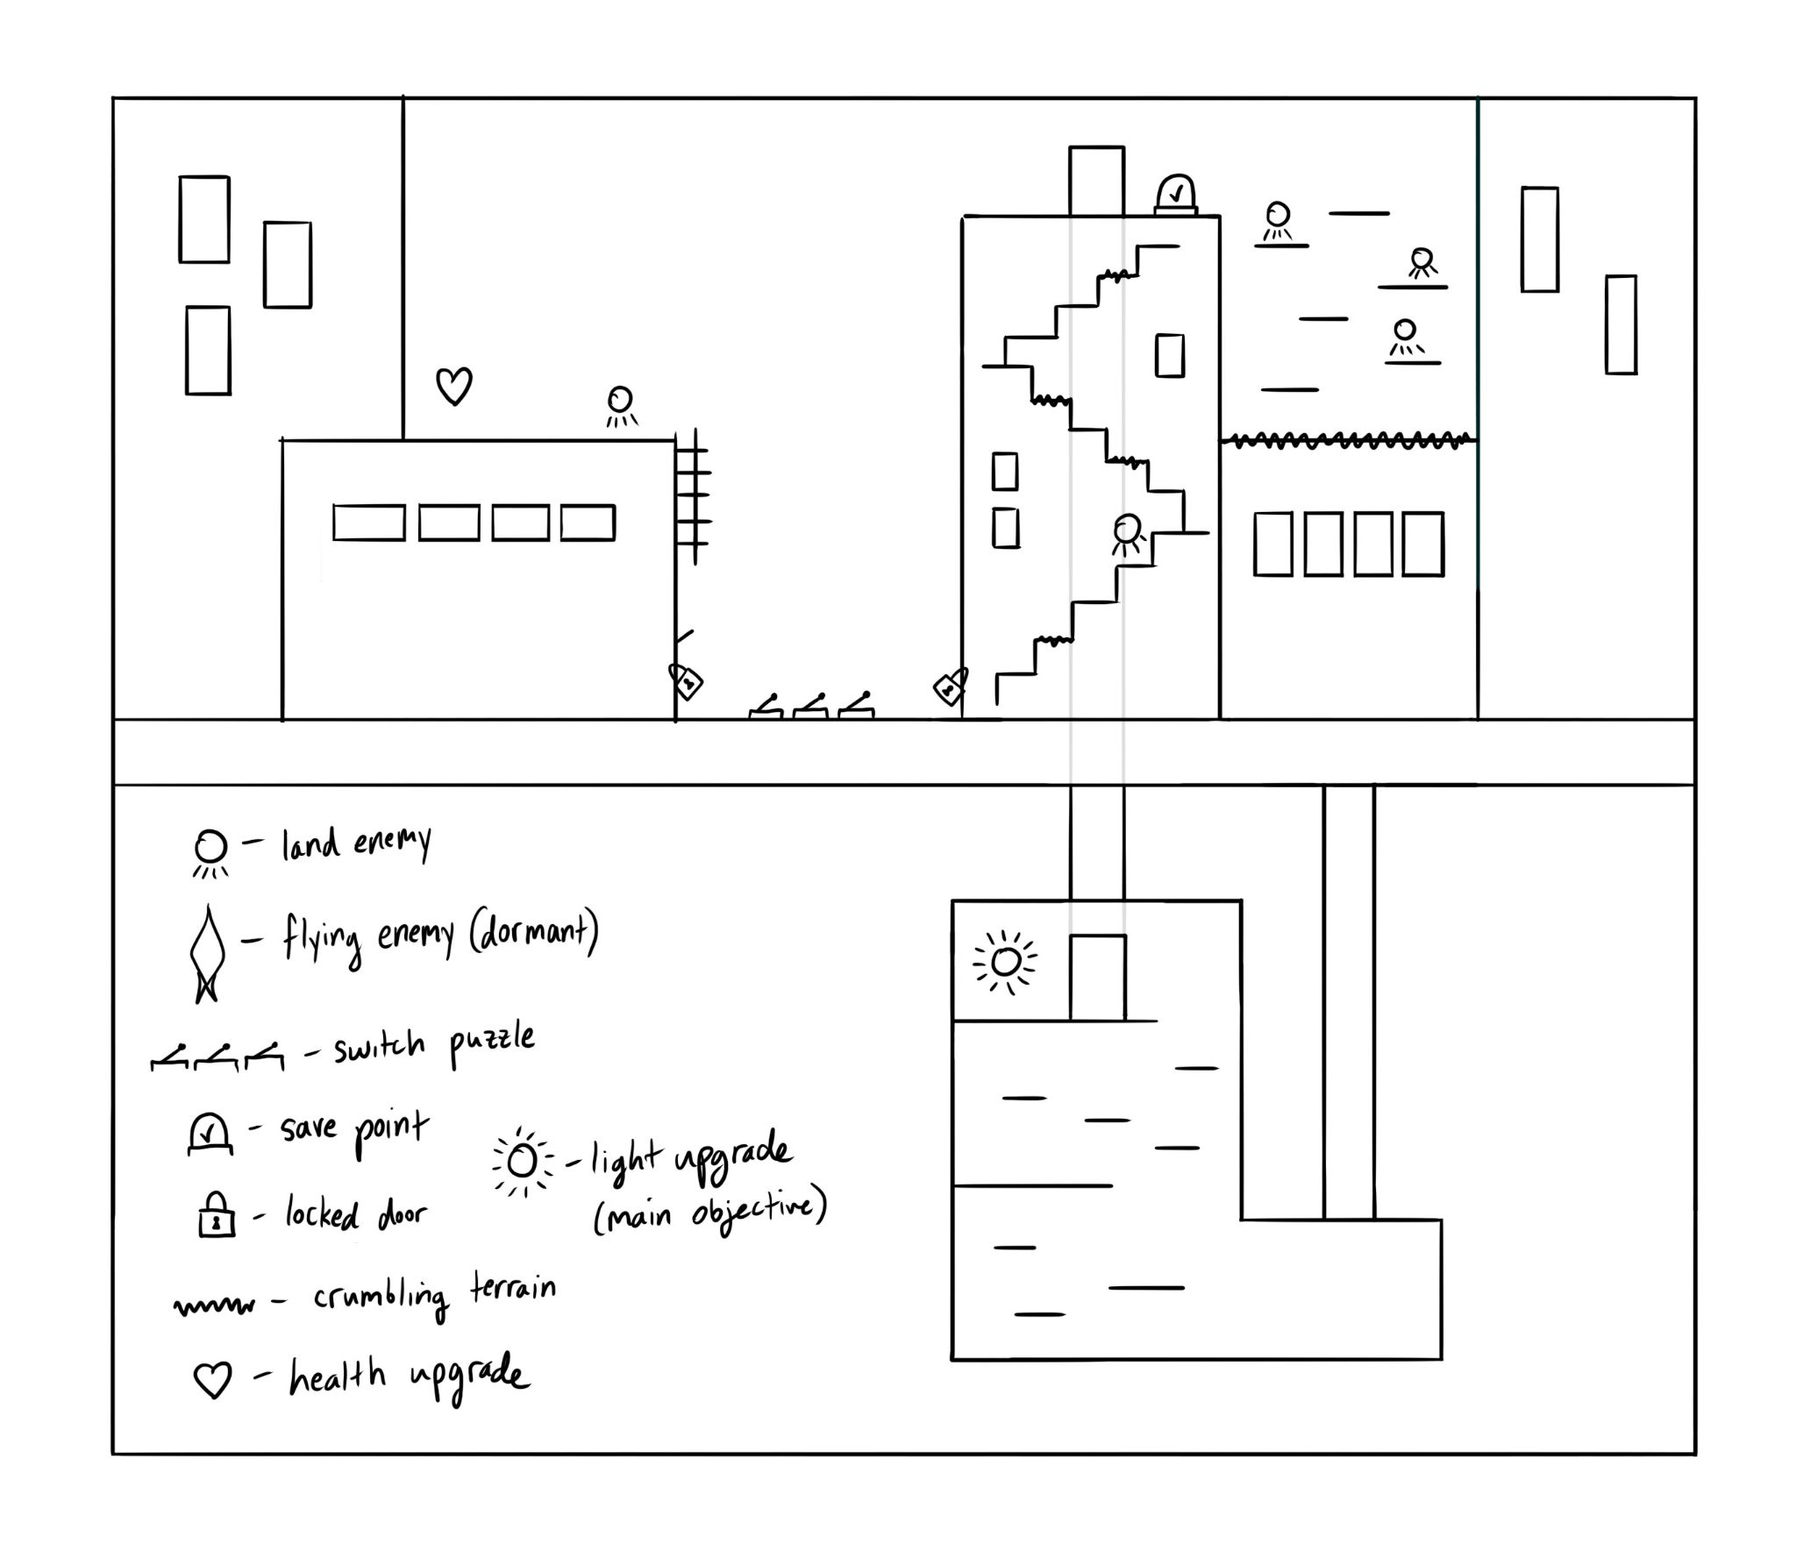
Completed Milestone:
Level Design/Game Flow
During production, mock level design was drawn out to get an understanding on the game flow. This includes placing enemies, upgrades, and puzzles.

Slide 8
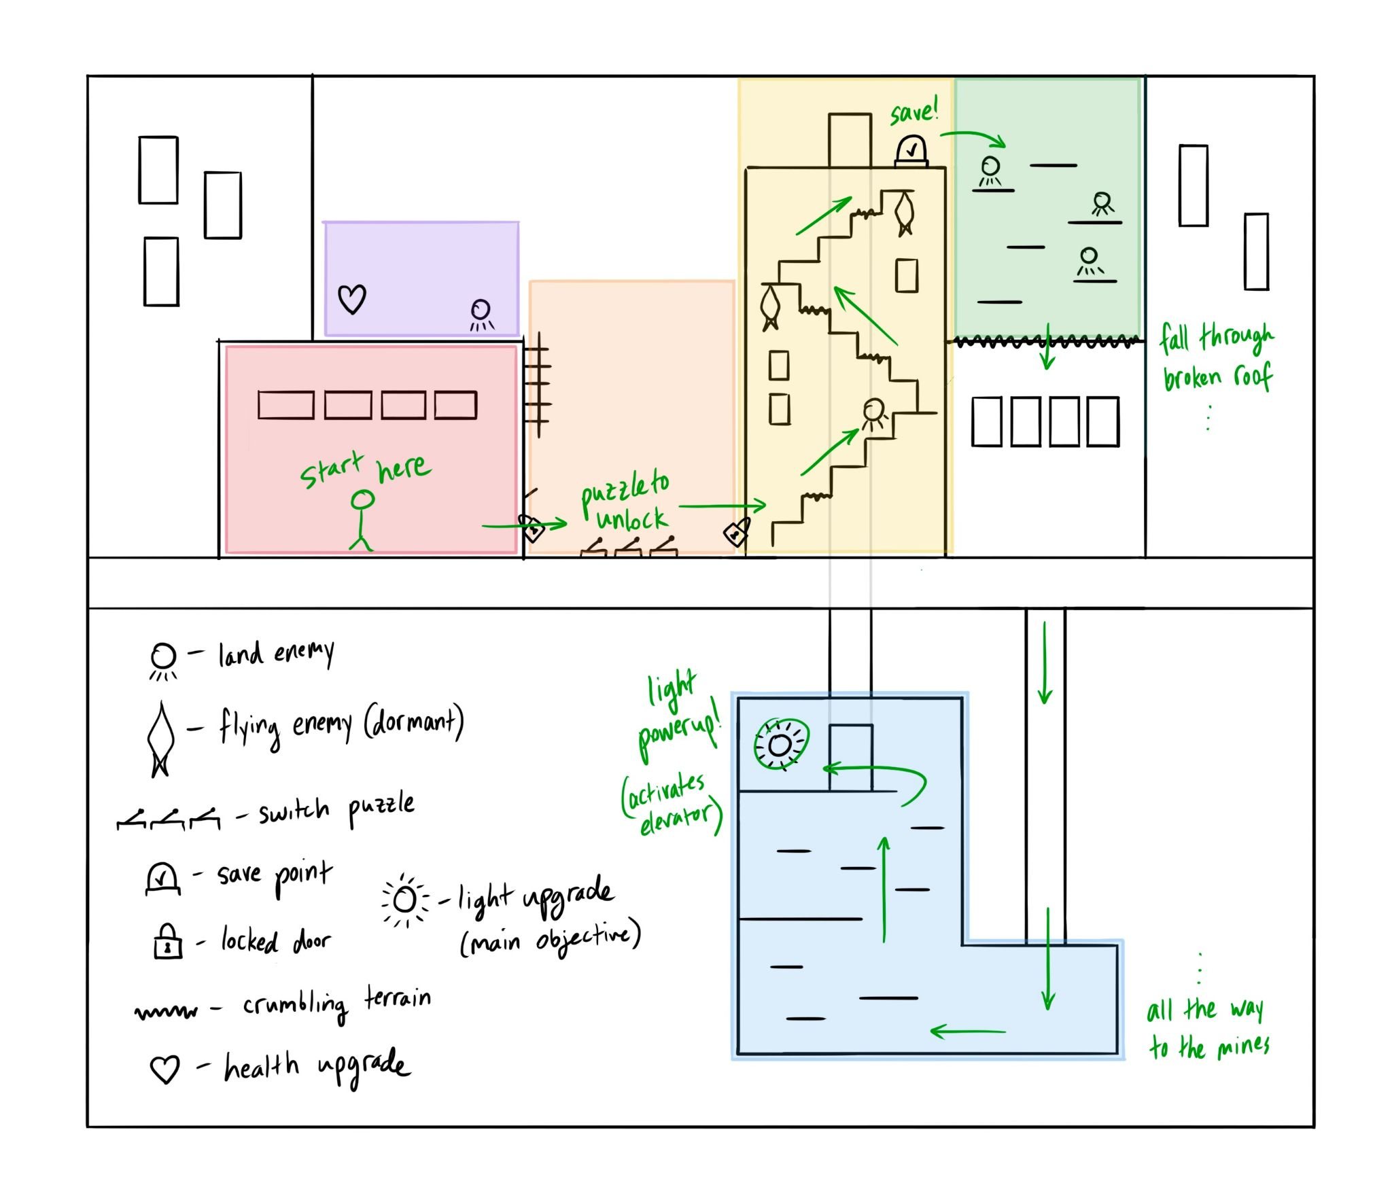
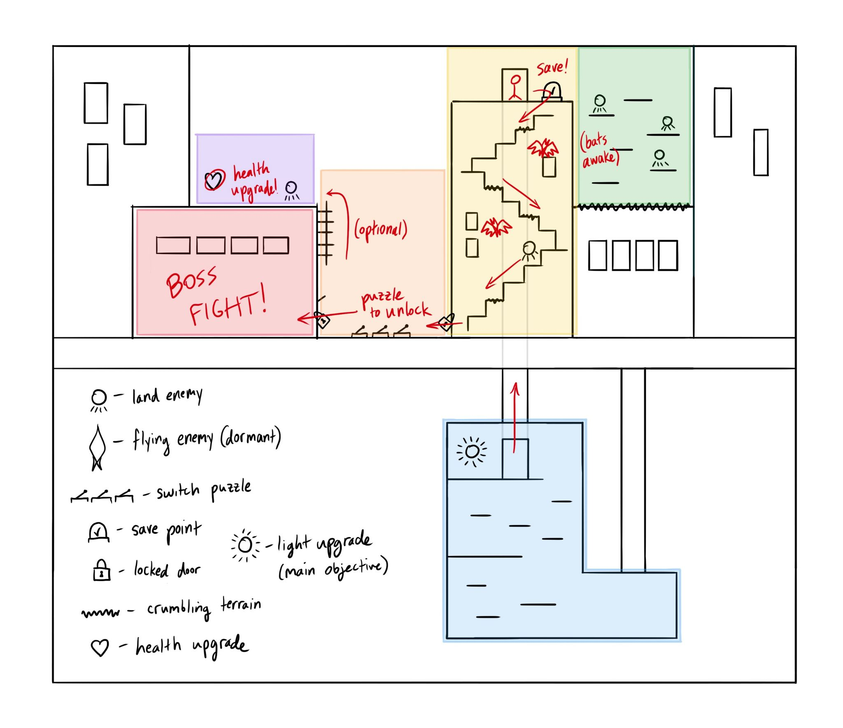

Slide 9
Completed Milestone:
Character Movement and Actions

Slide 10
Future Goals, Progress Updates
In the future, we are aiming to complete the first room of the game which includes the puzzle, boss, and lighting effect. Implementation of the actual scenes with a mock/rough-draft tileset to get an idea of the scale of levels and progression through each scene.
So far, the in-engine mock map implementation has given the team a scope and scale to work off of. Additionally, we have full implementation of character movement and shooting. As a team we are still brainstorming and finalizing ideas for our tile designs throughout our game and also our character design.

Slide 11
Individual Responsibilities
Creative Team:
Technical Team:
Alyssa Eriksen: Background Design
Anthony Gomez: Enemy Design Tiles
Evelyn Meckley: Outside City Design Tiles
Most responsibilities are shared between the team.
Cody Kelley: Player/Enemy Implementation
Christopher Kostas: Menu Implementation

